Slide 1
Classification Model for Lesion Images on the HAM10000 Dataset
CONOR HUH, MRIDUL JAIN, VISHAL SAXENA, LYNNE WANG
MIDS 281 COMPUTER VISION, UC BERKELEY
Notes:
Lynne ---

Slide 2

Presentation Roadmap
Addressing Class Imbalance in the HAM Dataset: Upsampling Techniques
Feature Extraction: Simple and Complex Approaches for Lesion Classification
Feature Selection Rationale and Interpretation
Classification Methods and Performance Analysis
Ensuring Generalizability: Data Splitting, Hyperparameter Search, and Evaluation
Balancing Efficiency and Accuracy: Comparative Analysis of Feature-Classifier Combinations
Notes:
Lynne ---

Slide 3
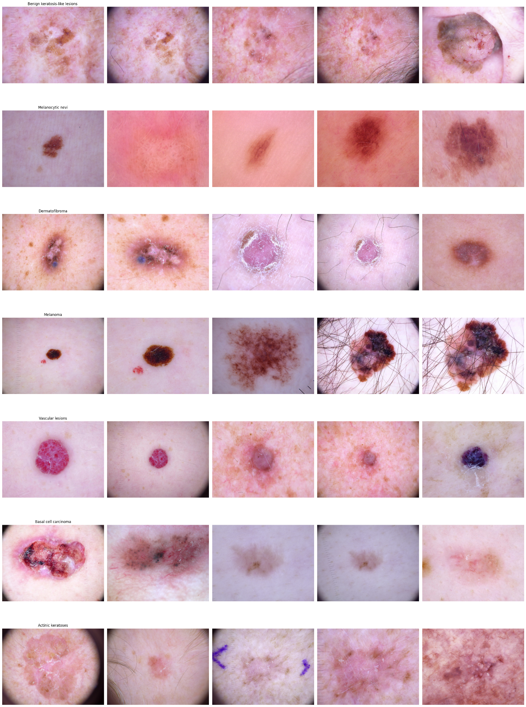
Overview of the HAM Lesion Dataset
Notes:
Lynne ---

Slide 4
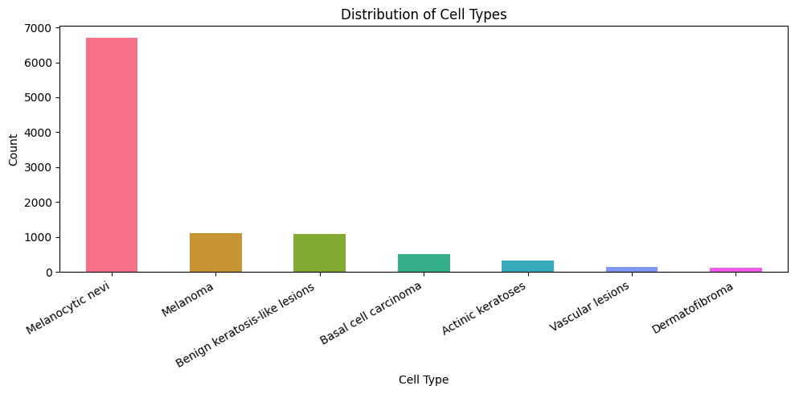
Addressing Class Imbalance in the HAM Dataset: 1. Oversampling 2. Class Weighting
Baseline performance
using a majority class classifier is 67%
Using LR for 8 x 8 downsampled pixel values is 69%
Notes:
Lynne

Slide 5
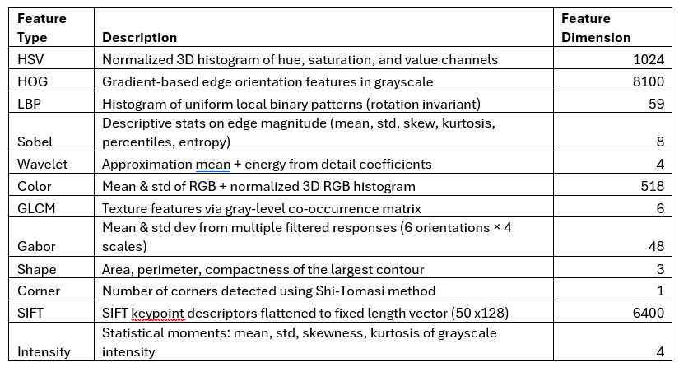
Simple Feature Extraction
Notes:
Lynne

Slide 6
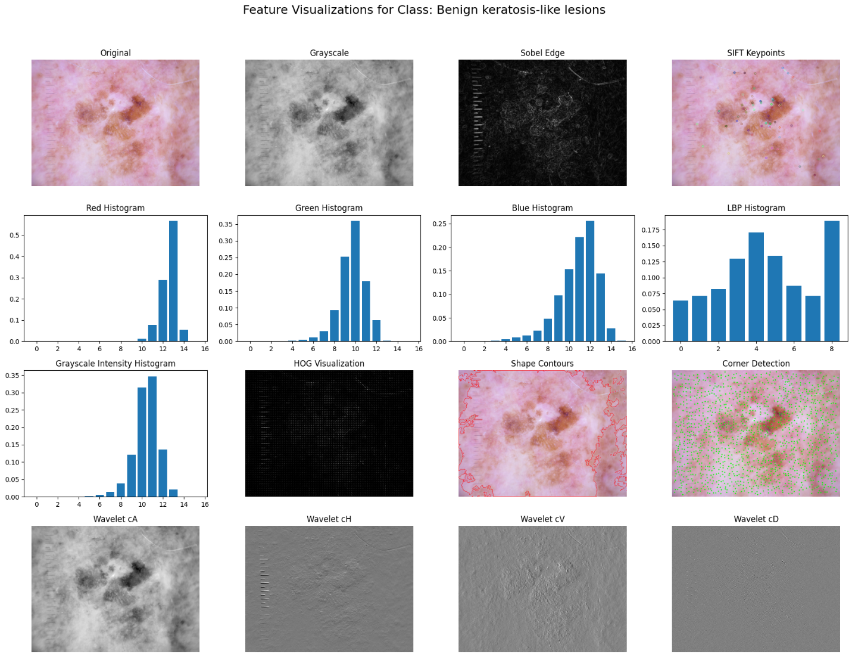
Visualization of Simple Features
Notes:
Lynne – explored removing ruler and hair, which did not improve the model.

Slide 7
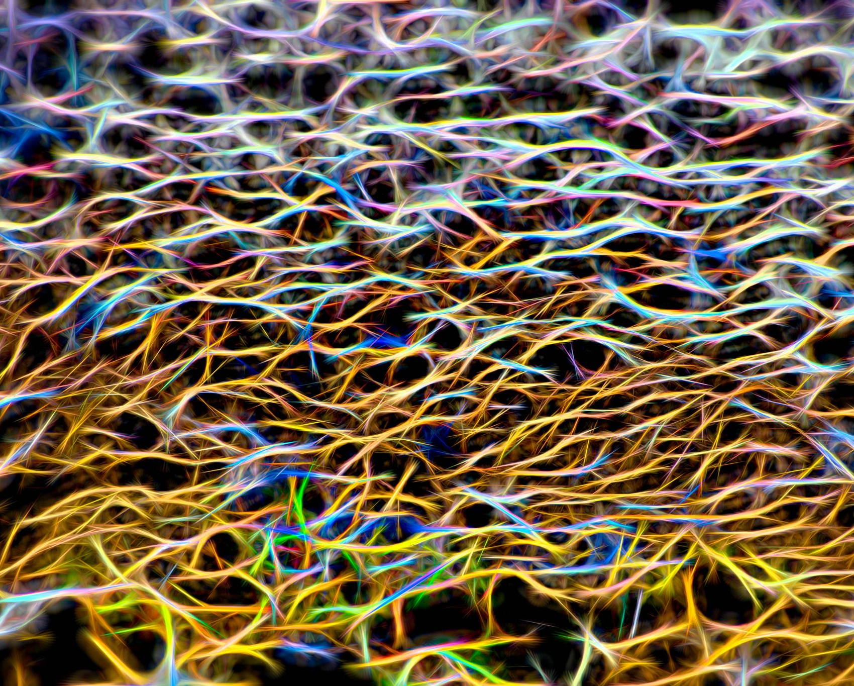
Complex Feature Extraction: 1. Vit 2. Clip
3. Resnet
Notes:
Mridul – embedding model – potential contrastive learning in the future

Slide 8
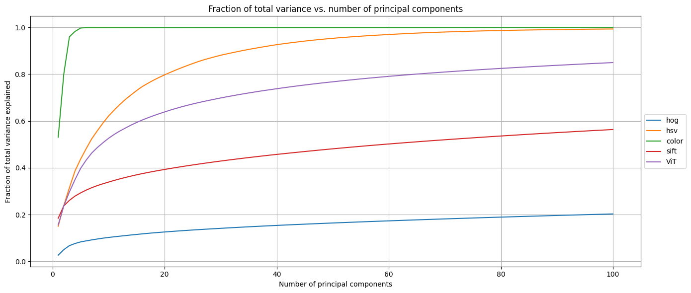
PCA of High Dimensional Features
Notes:
Mridul

Slide 9
AUC-ROC of Each Feature
 | mean_auc_roc | akiec | bcc | bkl | df | mel | nv | vasc
ViT | 0.918807 | 0.940296 | 0.946014 | 0.887043 | 0.913504 | 0.85162 | 0.908344 | 0.984825
color | 0.905113 | 0.903213 | 0.915098 | 0.86108 | 0.885808 | 0.881939 | 0.899282 | 0.989368
hsv | 0.900603 | 0.896002 | 0.910165 | 0.853191 | 0.867202 | 0.887739 | 0.897905 | 0.992014
gabor | 0.782414 | 0.881289 | 0.810262 | 0.734217 | 0.734684 | 0.777433 | 0.814387 | 0.724627
lbp | 0.741303 | 0.886965 | 0.730321 | 0.660882 | 0.672998 | 0.739452 | 0.801442 | 0.697058
glcm | 0.72045 | 0.829348 | 0.74523 | 0.680216 | 0.706693 | 0.730609 | 0.797681 | 0.553369
sobel | 0.709296 | 0.79191 | 0.722999 | 0.631536 | 0.59653 | 0.717012 | 0.76058 | 0.744508
sift | 0.701086 | 0.805895 | 0.732431 | 0.676648 | 0.618868 | 0.761287 | 0.754935 | 0.557536
intensity | 0.684763 | 0.7843 | 0.750177 | 0.642779 | 0.616066 | 0.689608 | 0.733427 | 0.576982
Wavelet | 0.631446 | 0.746668 | 0.615292 | 0.554721 | 0.553793 | 0.676672 | 0.673983 | 0.598994
hog | 0.618517 | 0.747637 | 0.566517 | 0.599901 | 0.592902 | 0.557032 | 0.624516 | 0.641112
shape | 0.614213 | 0.708403 | 0.657218 | 0.614838 | 0.527211 | 0.541862 | 0.677848 | 0.572112
corners | 0.507599 | 0.500864 | 0.503842 | 0.501728 | 0.514527 | 0.5002 | 0.500283 | 0.531749
Notes:
Mridul

Slide 10
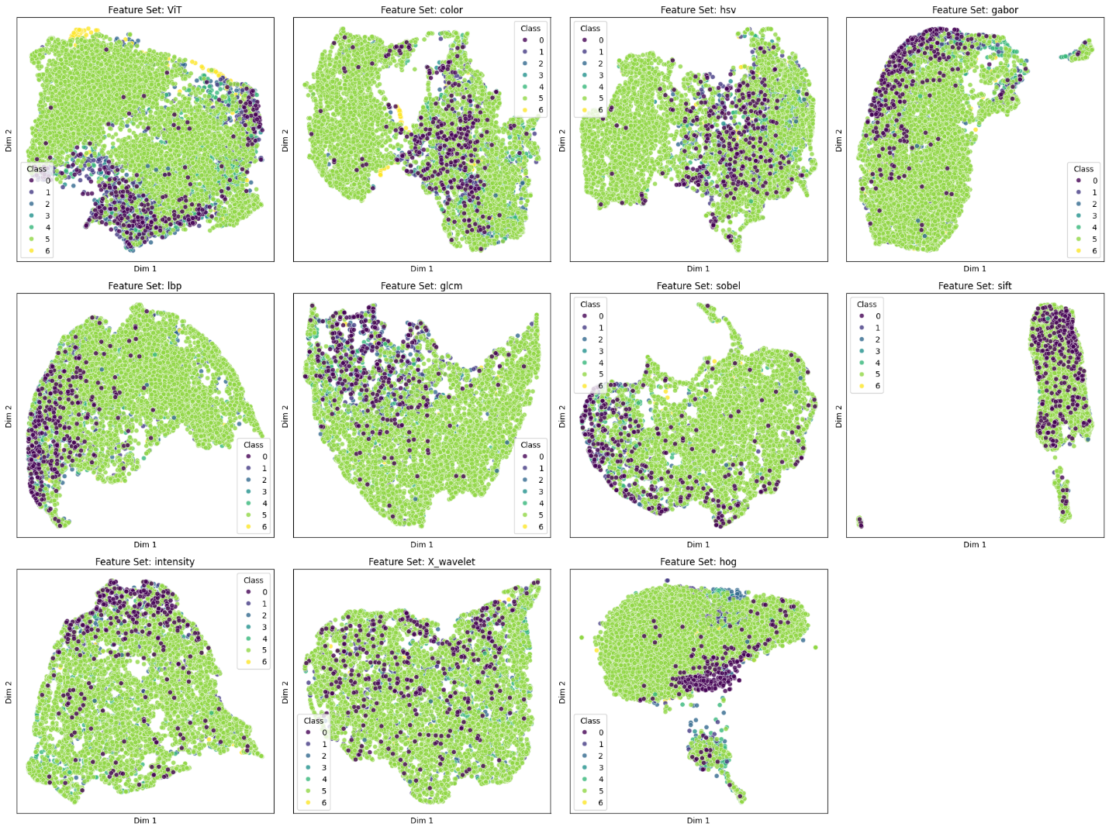
UMAP 2D Visualization of Features
Notes:
Mridul

Slide 11
Training and Evaluation Strategies
Notes:
Conor

Slide 12
Approach 1
Approach 1: (Evaluate on whole test set)
Produced a best model after optimizing for F1, and AUC-ROC using both Oversampling and Class Weighting approaches.
Best fit over: XGBC, RCF, Logistic Regression, and KNN
Identified top 5 features using feature trimming process.
Threshold tuning for AUC-ROC experiments
No Threshold Tuning for F1-Macro Experiments
All elements in test set included in evaluation (test set) metrics
Notes:
Conor

Slide 13

K-Fold + Oversampling or Class-Weighting
We first performed a stratified 80/20 train-test split, ensuring class distribution was preserved. The 20% test set was held out entirely for final evaluation.
The 80% training set was then further split (80/20) into training and validation subsets, and used with 5-fold Stratified K-Fold Cross-Validation for robust hyperparameter tuning.
We used Bayesian optimization (BayesSearchCV) with 5-fold cross-validation to identify optimal hyperparameters. For each hyperparameter candidate, five models were trained and evaluated across folds, and the average performance (macro F1 or AUC-ROC) was used to guide optimization.
After selecting the best hyperparameters, a final model was retrained on the entire 80% training set, incorporating the same oversampling or class-weighting strategy.
Threshold tuning was performed on a separate validation set to improve class-wise decision boundaries and enhance macro F1 performance on the multiclass task for AUC-ROC experiments.
Using a separate validation set, we treat each class as an independent binary classification problem to find its unique F1-score-maximizing probability threshold. The result is a set of tailored, per-class decision cutoffs used to enhance classification performance.
No threshold tuning was conducted on the F1 Optimized Experiments
Notes:
Conor
Global Confidence Threshold Tuning

Slide 14
Approach 1: Model Performance (1/2)
F1 Optimized Models w/ Oversampling
Model | Train Time (s) | Inference Time (s) | Best CV F1-Macro | Test Set AUC-ROC | Test Accuracy | Test Macro F1-Score | Best Hyperparameters
XGB* | 2364.96 | 0.11 | 0.6752 | 0.9699 | 0.8509 | 0.7407 | lr=0.29, max_depth=3, n_est=491
LS | 347.99 | 0.03 | 0.6556 | 0.9534 | 0.7902 | 0.6712 | C=2.07, penalty='l1'
RF | 347.47 | 0.31 | 0.5585 | 0.9347 | 0.6983 | 0.6119 | max_depth=10, n_bins=19, n_est=500
KNN | 105.28 | 0.17 | 0.3423 | 0.6654 | 0.613 | 0.3496 | n_neighbors=3, p=2
AUC-ROC Optimized Models w/ Oversampling
Model | Train Time (s) | Inference Time (s) | Best CV AUC-ROC | Test Set AUC-ROC | Test Accuracy | Test Macro F1-Score | Best Hyperparameters
XGB | 707.4 | 0.11 | 0.9566 | 0.9649 | 0.8268 | 0.6948 | lr=0.30, max_depth=3, n_est=412
RF | 86.32 | 0.3 | 0.9435 | 0.9514 | 0.7907 | 0.6229 | max_depth=45, n_bins=18, n_est=500
LR | 347.99 | 0.03 | 0.9385 | 0.9534 | 0.7987 | 0.6761 | C=0.69, penalty='l1'
KNN | 6.96 | 0.07 | 0.7335 | 0.7221 | 0.5452 | 0.3142 | n_neighbors=30, p=2
Notes:
Conor

Slide 15
Approach 1: Model Performance (2/2)
F1 Optimized Models w/ Class Balancing
Model | Train Time (s) | Inference Time (s) | Best CV F1-Macro | Test Set AUC-ROC | Test Accuracy | Test Macro F1-Score | Best Hyperparameters
XGB | 2038.62 | 0.05 | 0.6244 | N/A | 0.8333 | 0.6887 | lr=0.16, max_depth=5, n_est=319
LR | 1627.75 | 0.02 | 0.6369 | N/A | 0.8047 | 0.6742 | C=62.71, penalty='l1'
RF | 302.21 | 0.43 | 0.4007 | N/A | 0.7585 | 0.4048 | max_depth=33, n_bins=101, n_est=212
KNN | 84.33 | 0.09 | 0.3142 | N/A | 0.7083 | 0.3421 | n_neighbors=15, p=2
AUC-ROC Optimized Models w/ Class Balancing
Model | Train Time (s) | Inference Time (s) | Best CV AUC-ROC | Test Set AUC-ROC | Test Accuracy | Test Macro F1-Score | Best Hyperparameters
XGB | 151.56 | 0.05 | 0.9499 | 0.9587 | 0.8228 | 0.6638 | lr=0.17, max_depth=14, n_est=187
LS*** | 76.91 | 0.02 | 0.9457 | 0.9472 | 0.7942 | 0.5898 | C=105.76, penalty='l2'
RF | 21.97 | 0.27 | 0.9352 | 0.9504 | 0.7952 | 0.5842 | max_depth=23, n_bins=95, n_est=470
KNN** | 1.14 | 0.04 | 0.827 | 0.8194 | 0.7063 | 0.3261 | n_neighbors=26, p=2
Notes:
Conor

Slide 16
Approach 1: Best Model
Class | Precision | Recall | F1-Score | Support
0 (Actinic keratoses) | 0.683333 | 0.621212 | 0.650794 | 66
1 (Basal cell carcinoma) | 0.712766 | 0.650485 | 0.680203 | 103
2 (Benign keratosis-like lesions) | 0.684932 | 0.688073 | 0.686499 | 218
3 (Dermatofibroma) | 0.866667 | 0.565217 | 0.684211 | 23
4 (Melanoma) | 0.711538 | 0.666667 | 0.688372 | 223
5 (Melanocytic nevi) | 0.913931 | 0.940691 | 0.927118 | 1341
6 (Vascular lesions) | 0.92 | 0.821429 | 0.867925 | 28
accuracy | 0.850904 | 0.850904 | 0.850904 | 2003
macro avg | 0.784738 | 0.707682 | 0.740732 | 2003
weighted avg | 0.847812 | 0.850904 | 0.848619 | 2003
* Full test set (20% split)
Notes:
Conor

Slide 17
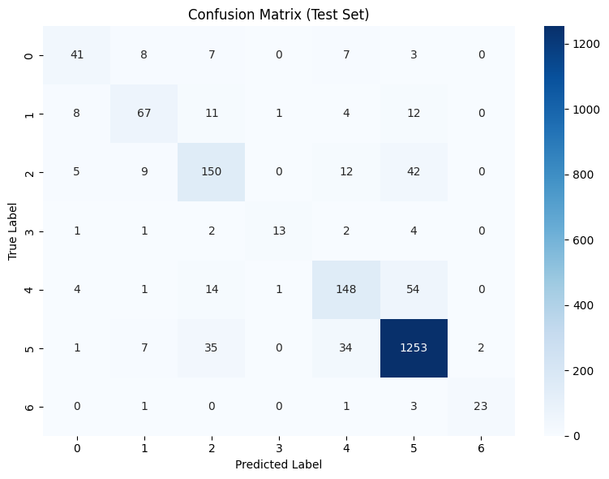
Approach 1: Best Model
Notes:
Conor

Slide 18
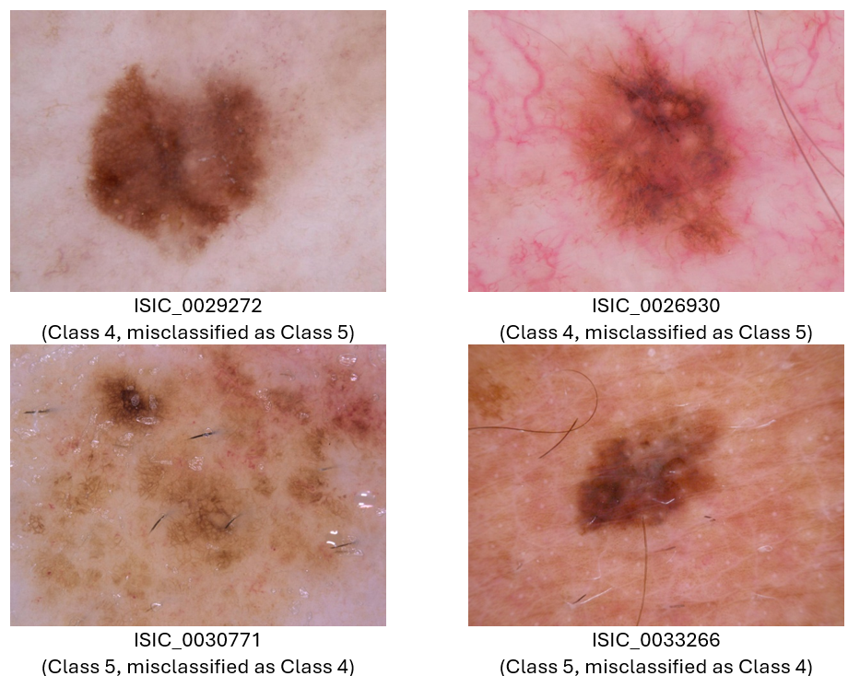
Approach 1
Case Analysis: Misclassification Between Class 4 and Class 5
Notes:
Conor

Slide 19
Approach 2
Approach 2: (Production Model, evaluate on subset of test set)
Using the best model (XGBoost Classifier) from Approach 1:
Best Experiment Design (optimize for F1 using oversampling)
Top 5 features
Then, applied threshold tuning with low confidence masking to evaluate inclusion of complex features from ViT, Resnet, and CLIP.
Note: ViT results are presented in both the runs (delta is inclusion / exclusion of threshold tuning with low confidence masking). Low confidence predictions, excluded from test set reported metrics
Notes:
Vishal & Conor

Slide 20
Approach 2: Best Model from previous iteration, plus threshold tuning with masking. But first, level setting on evaluation metrics…
Metric | Description
Best CV F1-Macro | • Measures generalization performance during cross-validation. • “How well model performs on unseen data — validation fold in each CV split.” • F1-Macro scores from all k folds are averaged to get the final CV F1-Macro. • Threshold-tuning dependent — since final predictions (argmax or tuned thresholds) are used in CV scoring.
Test Set AUC-ROC | • Measures how well the model ranks or separates the positive class from the negative class using a one-vs-rest approach. Reflects the model’s discriminative ability, not classification thresholds. Drawback: AUC can be high even if the model is never correct in its top prediction — it measures ranking, not exact label prediction. • Evaluated on the held-out test set (20%). • Not threshold-tuning dependent — uses continuous prediction scores, not hard labels.
Test Accuracy | • In multi-class classification, measures how many predictions were correct, regardless of class. • Limited for imbalanced datasets — accuracy can be dominated by majority classes. • Computed on hold-out 20% test data. • Threshold-tuning dependent — final class labels are derived using threshold or argmax.
Test F1-Macro | • Compute F1 score for each class independently, then take the unweighted average across all classes. • Advantage: Treats all classes equally, regardless of how rare they are. • Ideal for imbalanced datasets like HAM10000. • Evaluated on hold-out 20% test set. • Threshold-tuning dependent — F1 is based on predicted labels after thresholding.
All test metrics evaluated on masked hold out test set. CV F1-macro on valuation folds of training set (80%).
F1-Macro is the most appropriate metric to assess performance of our imbalanced data set.
Case: High Test-AUC-ROC, Low CV F1-Macro. May happen if no thresholding scheme was used or classification boundaries are close together .
Notes:
Vishal

Slide 21
Approach 2: Used Threshold Tuning (masking), but why is it important?
It increases trustworthiness of results by rejecting low confidence predictions.
It allows for preference for no prediction over a bad prediction. That is: “I don't know” is better than a wrong cancer diagnosis
"Only trust predictions if I'm at least T% confident"
In our case when 500 low confidence predictions were masked out, F1 Macro score improved. The fine-tuned threshold probability was 0.9.
See Appendix for the Threshold Tuning Algorithm used by Approach 2
Notes:
Vishal

Slide 22
Approach 2: Best Model from previous iteration, plus threshold tuning
Approach 1: F1 optimization with random oversampling, does not use threshold tuning. Identified best model: XGBC (lr=0.29, max_depth=3, n_est=491)
Model | Best CV F1-Macro | Test Set AUC-ROC | Test Accuracy | Test Macro F1-Score | Best Hyperparameters
ViT | 0.6752 | 0.9699 | 0.8509 | 0.7407 | lr=0.29, max_depth=3, n_est=491
Approach 2: F1 optimization with random oversampling, uses threshold tuning and masking. Uses same best model from Approach 1: XGBC (lr=0.29, max_depth=3, n_est=491)
Model | Best CV F1-Macro | Test AUC-ROC | Test Accuracy | Test F1-Macro | Best Hyperparameters
ViT | 0.682016 | 0.982986 | 0.938124 | 0.857187 | lr=0.29, max_depth=3, n_est=491
ResNet | 0.628186 | 0.974642 | 0.924983 | 0.799887 | lr=0.29, max_depth=3, n_est=491
CLIP | 0.617616 | 0.976536 | 0.923395 | 0.784727 | lr=0.29, max_depth=3, n_est=491
ViT with threshold tuning and low confidence masking (Approach 2) outperforms VIT run from Approach 1 (highest F1-Macro score) because approach 2 used threshold tuning with masking of low confidence classifications.
Both Resnet and CLIP runs also outperform best model run from Approach 1 because of the same reason.
Approach 1’s high Test AUC-ROC but low CV F1 Macro we believe is due to the fact that no thresholding w/ masking was applied.
Notes:
Vishal

Slide 23
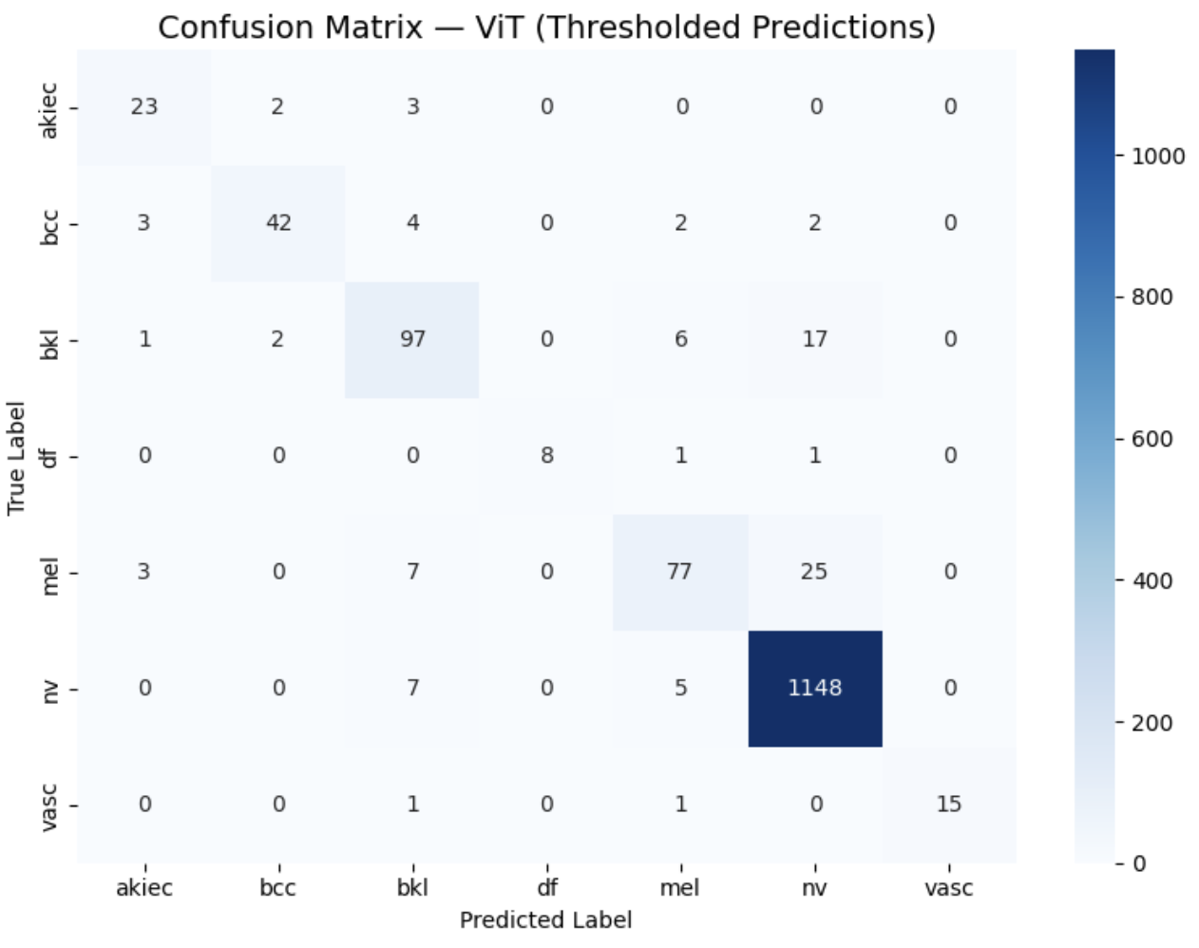
Approach 1 ViT
Approach 2 ViT: Effect of Masking Out Low Confidence Predictions Using Threshold Tuning
Approach 2 ViT
Confusion Matrix, No Threshold Tuning or masking
Confusion Matrix, Threshold Tuning with masking out of (500) Low Confidence Predictions*
* y_test shape = (2003,). y_test_masked.shape = (1503,)
Notes:
Vishal

Slide 24
Approach 1 vs 2 Test Set Differences
Class | Approach 1 Support | Approach 2 Support | Absolute Delta | Percentage Delta (A1 vs A2)
akiec | 66 | 28 | -38 | - 80.85%
bcc | 103 | 53 | -50 | - 64.10%
bkl | 218 | 123 | -95 | - 55.72%
df | 23 | 10 | -13 | - 78.79%
mel | 223 | 112 | -111 | - 69.77%
nv | 1341 | 1160 | -181 | - 14.47%
vasc | 28 | 17 | -11 | - 48.89%
Total | 2003 | 1503 | -500 | - 58.94% avg reduction per class
* Average Minority class only % reduction: -66.35%
Notes:
Vishal - Ok. I will cover this. Lets avoid abrupt transitions.

Slide 25
Approach 2 ViT: Per Class Metrics
Class | precision | recall | f1-score | support
akiec | 0.7667 | 0.8214 | 0.7931 | 28
bcc | 0.913 | 0.7925 | 0.8485 | 53
bkl | 0.8151 | 0.7886 | 0.8017 | 123
df | 1 | 0.8 | 0.8889 | 10
mel | 0.837 | 0.6875 | 0.7549 | 112
nv | 0.9623 | 0.9897 | 0.9758 | 1160
vasc | 1 | 0.8824 | 0.9375 | 17
Majority class has the highest F1 score, but even the most minority class (with only 10 test samples) has an F1 score of 0.8889, suggesting a good – and high confidence – representation of minority classes in the model
* Full test set size: 2003
* Masked test set size: 1503 (-500 low confidence predictions)
Notes:
Vishal

Slide 26
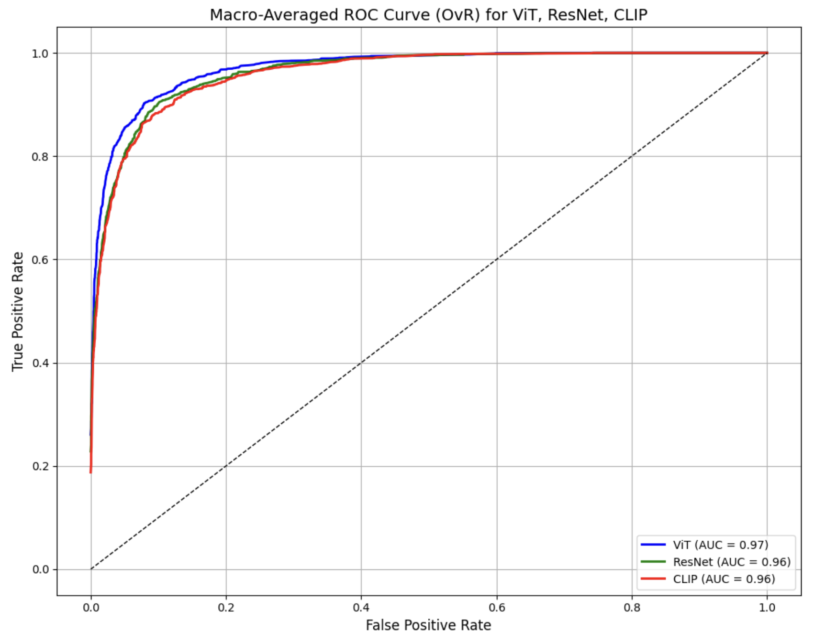
Approach 2: Best Model from previous iteration, plus threshold tuning & low confidence masking
ViT with threshold tuning is the best performer.
Resnet matches CLIP’s performance, and actually outperforms CLIP for low FPR-high TPR rates suggesting that ResNet may extract more domain-aligned mid-level features (e.g., edge patterns, texture) than CLIP, which is trained more generically on vision-language alignment.
Notes:
Vishal

Slide 27

Future Work:
Fine-Tune Deep Learning Models such as ViT with Contrastive Learning and QLoRA: Use contrastive learning, to better capture lesion-specific representations and improve separability across classes, and Quantized Low Rank Adaptation (QLoRA) to facilitate high dimension training on moderate compute.
Simple Feature Refinement and Expansion: revisit shape, boundary, color, and edge-based simple features—using domain expert guidance—to better capture lesion structure and improve class separability.
Preprocessing Enhancements: Use of lesion localization and contrast enhancement may help the model focus more directly on relevant lesion areas while reducing background noise.
Model ensembling improves predictions for underrepresented classes by averaging outputs from multiple models, reducing variance and enhancing stability. This aggregation helps capture weak signals, increasing the likelihood of correctly predicting rare classes.
Real-World Validation to evaluate model performance on out-of-distribution data and assess generalizability beyond the HAM10000 dataset.
Notes:
Vishal

Slide 28
Thank You!

Slide 29
Appendix Approach 2: Threshold Tuning Algorithm
80/20 Train-Test Split
Split the full dataset into training (80%) and test (20%) sets using stratification to preserve class distribution.
Stratified K-Fold + Random Oversampling on Training Folds (excluding majority class) a. For each fold:
Train the model on K−1K−1 folds (with oversampling).
Predict class probabilities on the held-out validation fold (this is the out-of-fold (OOF) prediction). b. Collect predicted class probabilities for each validation fold. c. At the end, you have a complete OOF probability array and corresponding ground-truth labels for the entire training set.
Threshold Tuning
Pass the OOF predicted probabilities and true labels to the threshold tuning function. a. The function tries a set of thresholds T∈[0.1,0.9]T∈[0.1,0.9] (using np.linspace).
For each threshold TT:
Reject (set label to -1) any prediction where max class probability < T (low confidence).
Compute the macro F1 score only on the retained (high-confidence) predictions. b. Return the optimal threshold T∗T∗ that maximizes macro F1.
Retrain Final Model
Train a final model MM on the full oversampled training data (X_train_ROS, y_train_ROS).
Predict on Held-Out Test Set
Use model MM to predict class probabilities on X_test.
Convert Probabilities to Class Labels using T∗T∗
For each prediction:
If max(probability) >= T*, keep argmax(probability) as predicted class.
Otherwise, reject prediction by assigning -1.
Mask Out Low-Confidence Predictions
Filter out predictions where label = -1.
Compute Macro F1 Score
Compute macro F1 using only the high-confidence predictions and their true labels.
Notes:
Vishal

